Slide 1

Case Study: Amazon

Slide 2
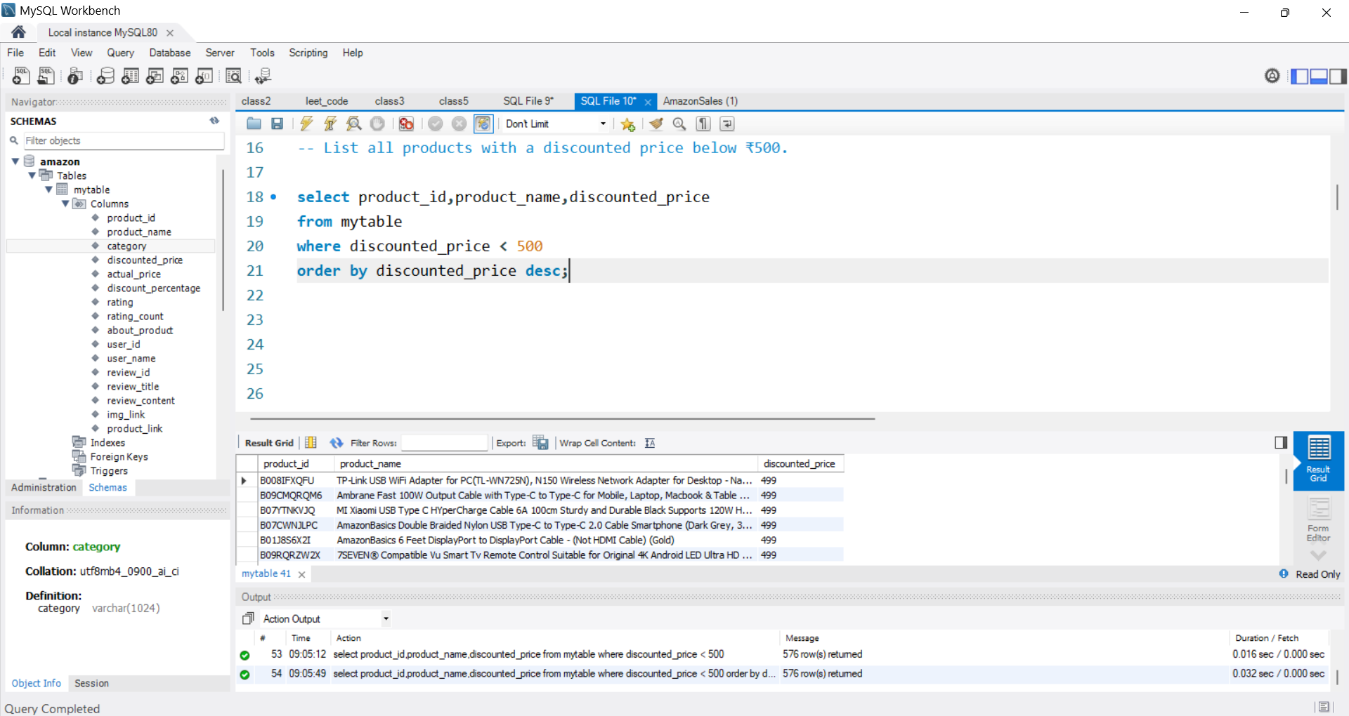
1. List all products with a discounted price below ₹500

Slide 3
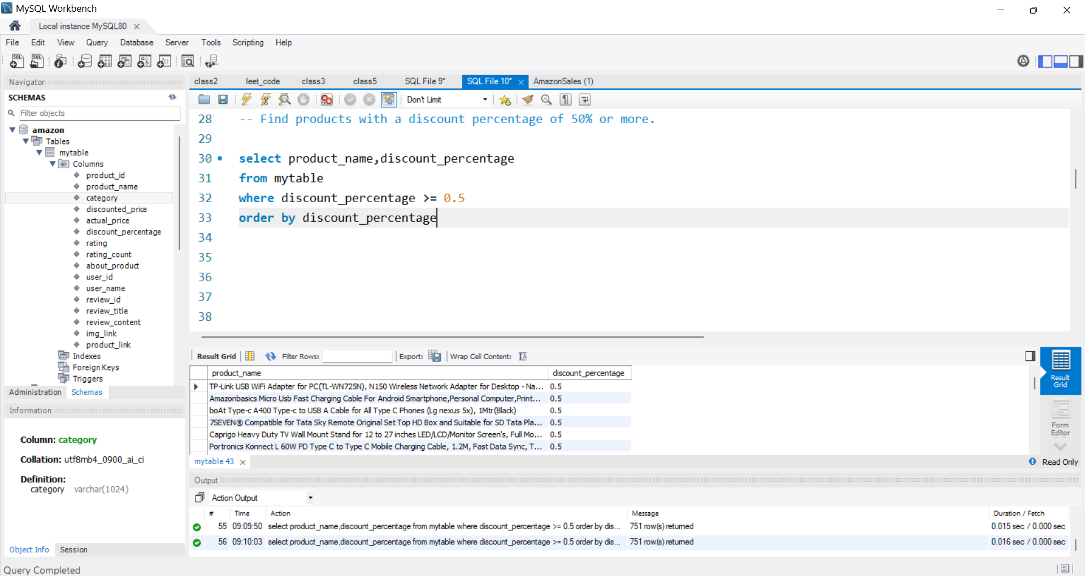
2. Find products with a discount percentage of 50% or more

Slide 4
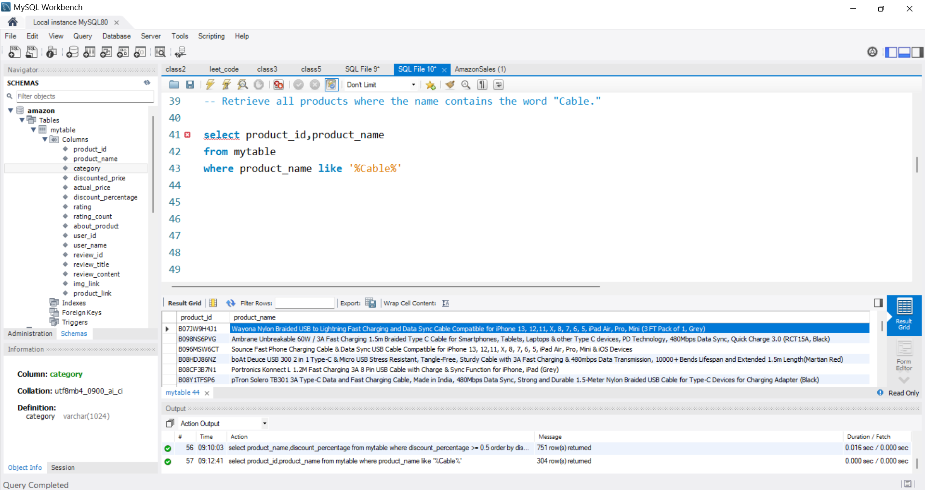
3. Retrieve all products where the name contains the word "Cable."

Slide 5
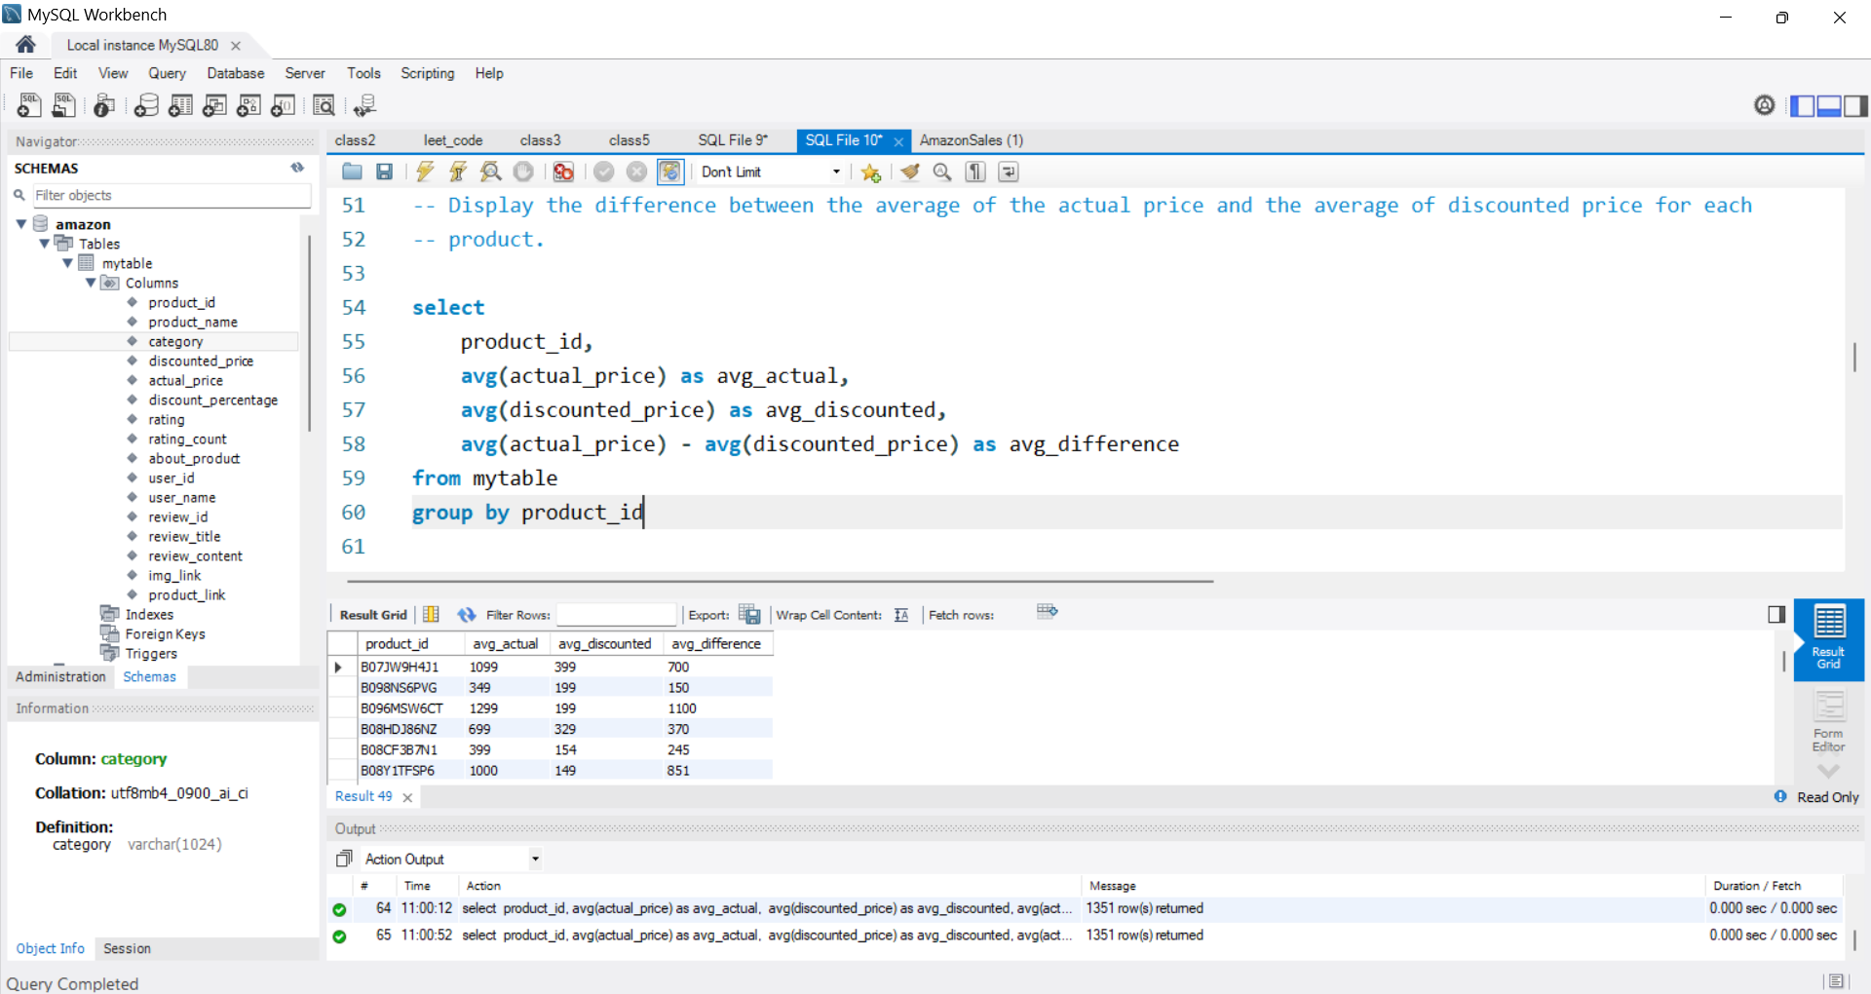
4. Display the difference between the average of the actual price and the average of discounted price for each product

Slide 6
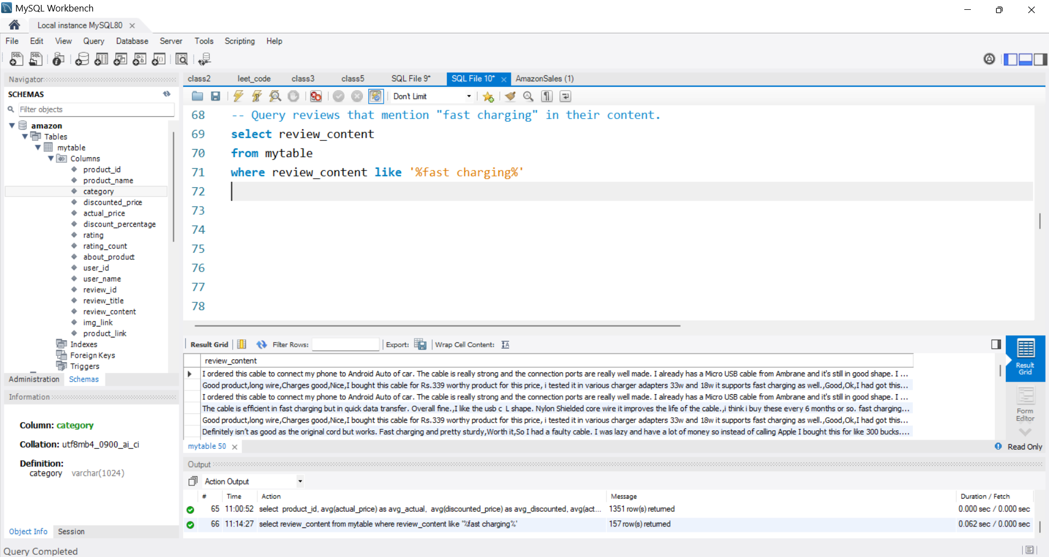
5. Query reviews that mention "fast charging" in their content

Slide 7
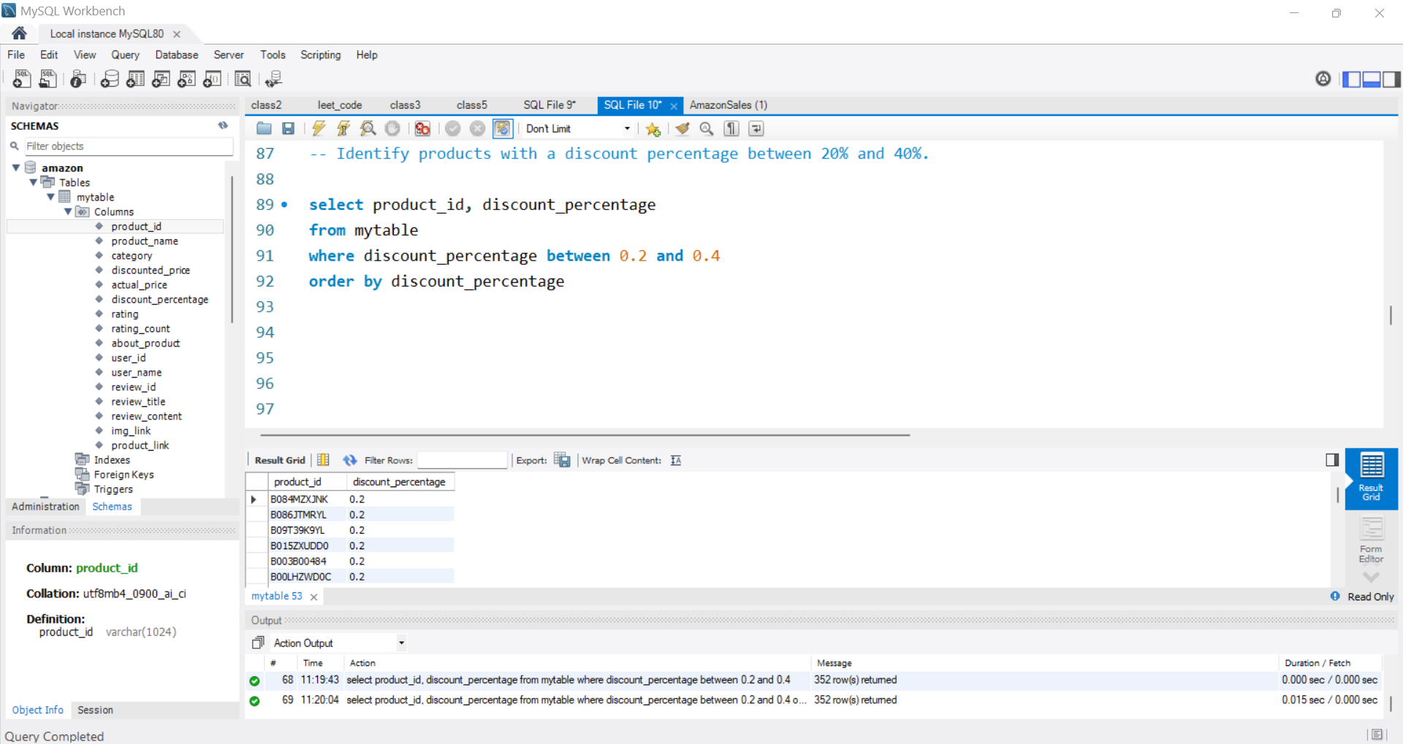
6. Identify products with a discount percentage between 20% and 40%

Slide 8
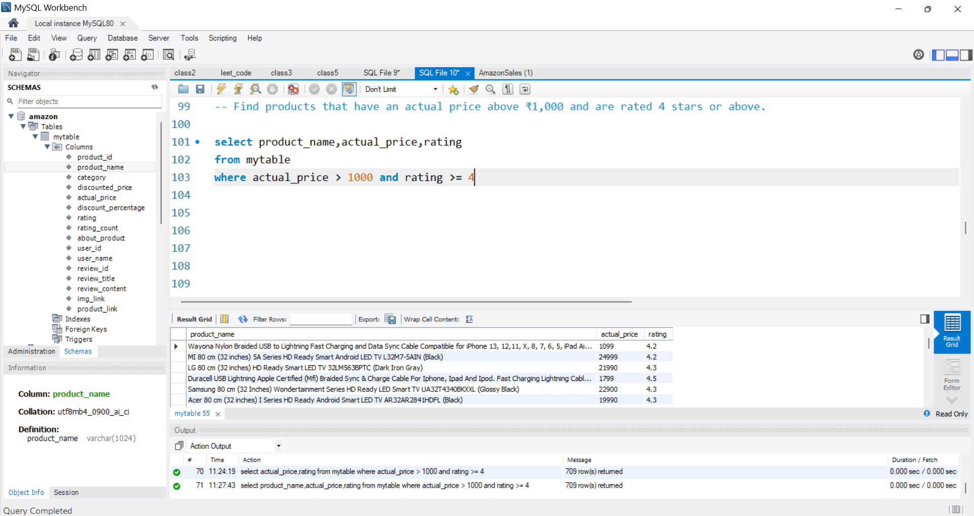
7. Find products that have an actual price above ₹1,000 and are rated 4 stars or above

Slide 9
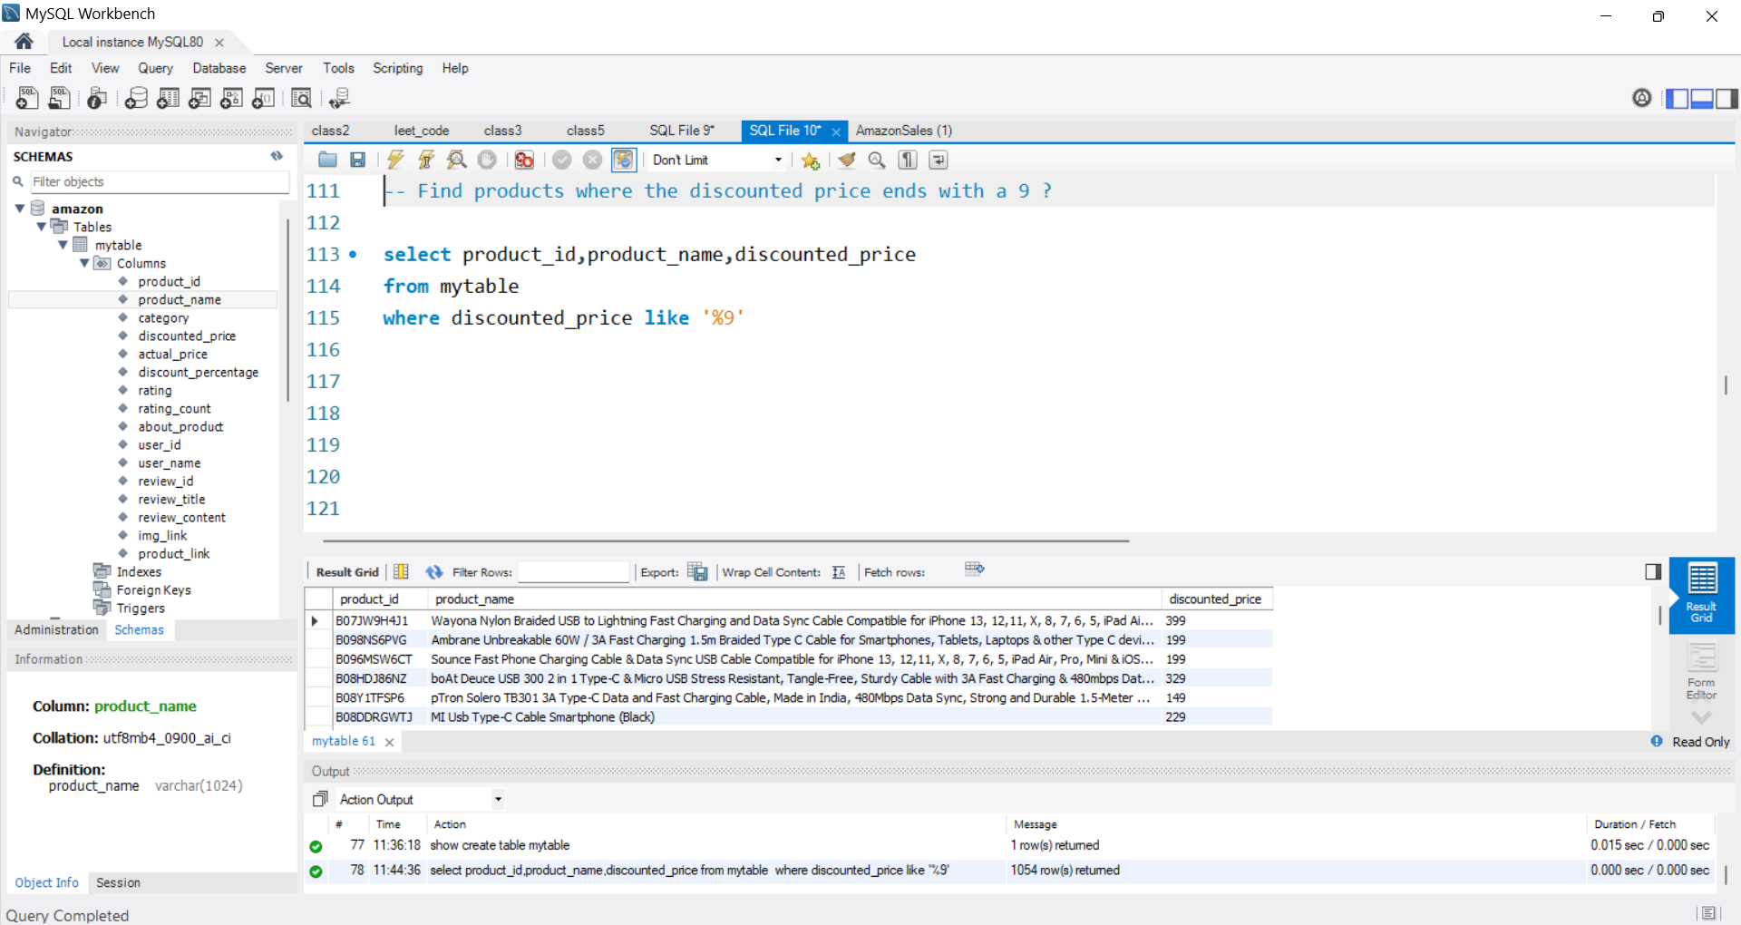
8. Find products where the discounted price ends with a 9

Slide 10
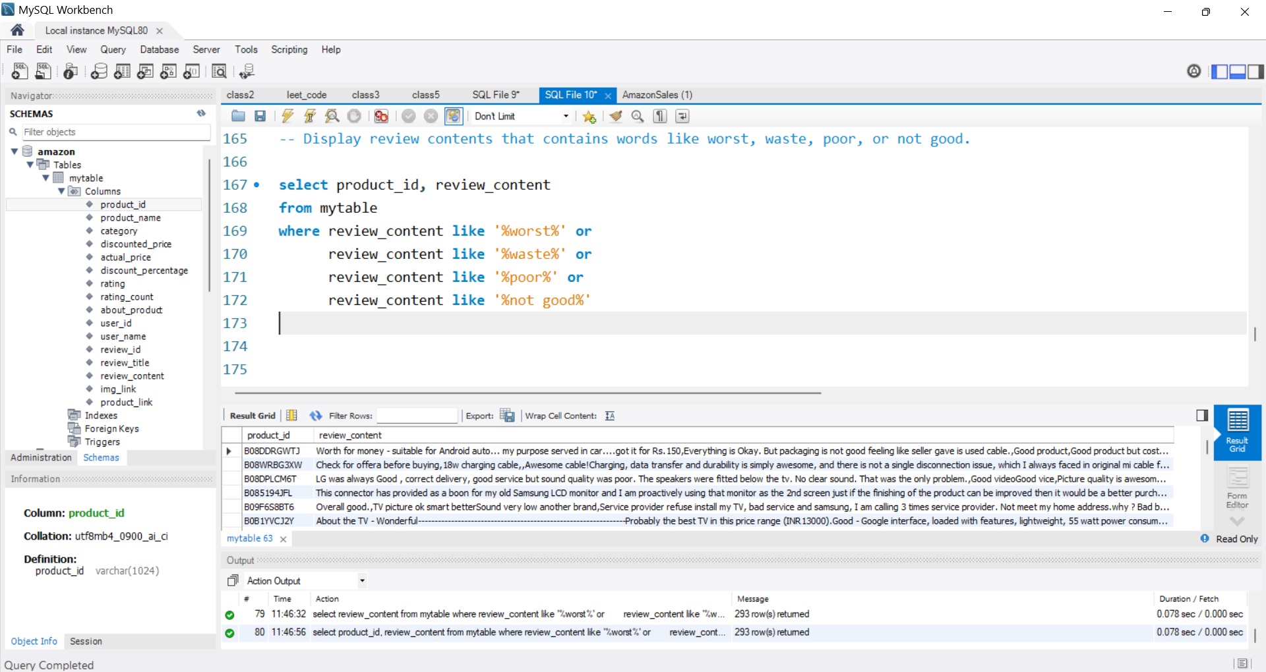
9. Display review contents that contains words like worst, waste, poor, or not good

Slide 11
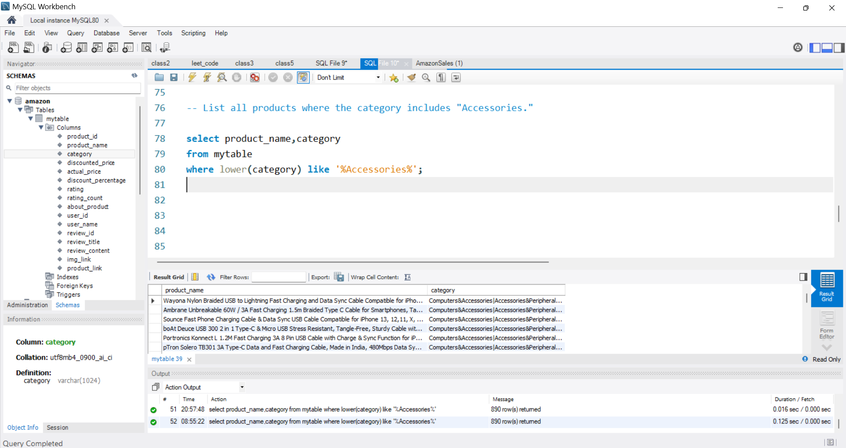
10. List all products where the category includes "Accessories."

